Slide 1
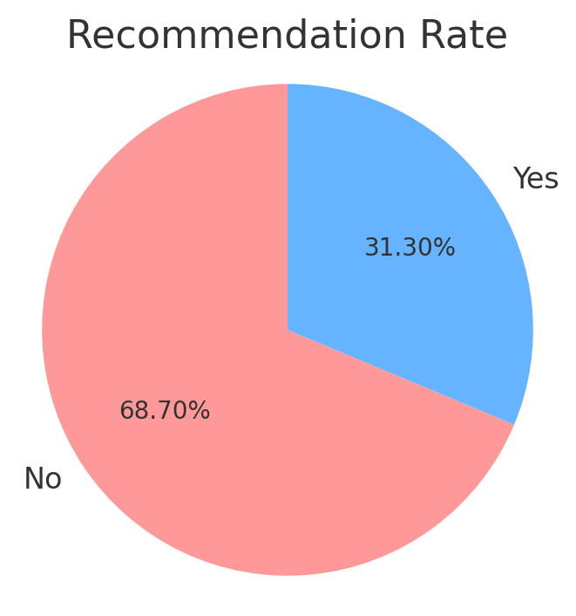
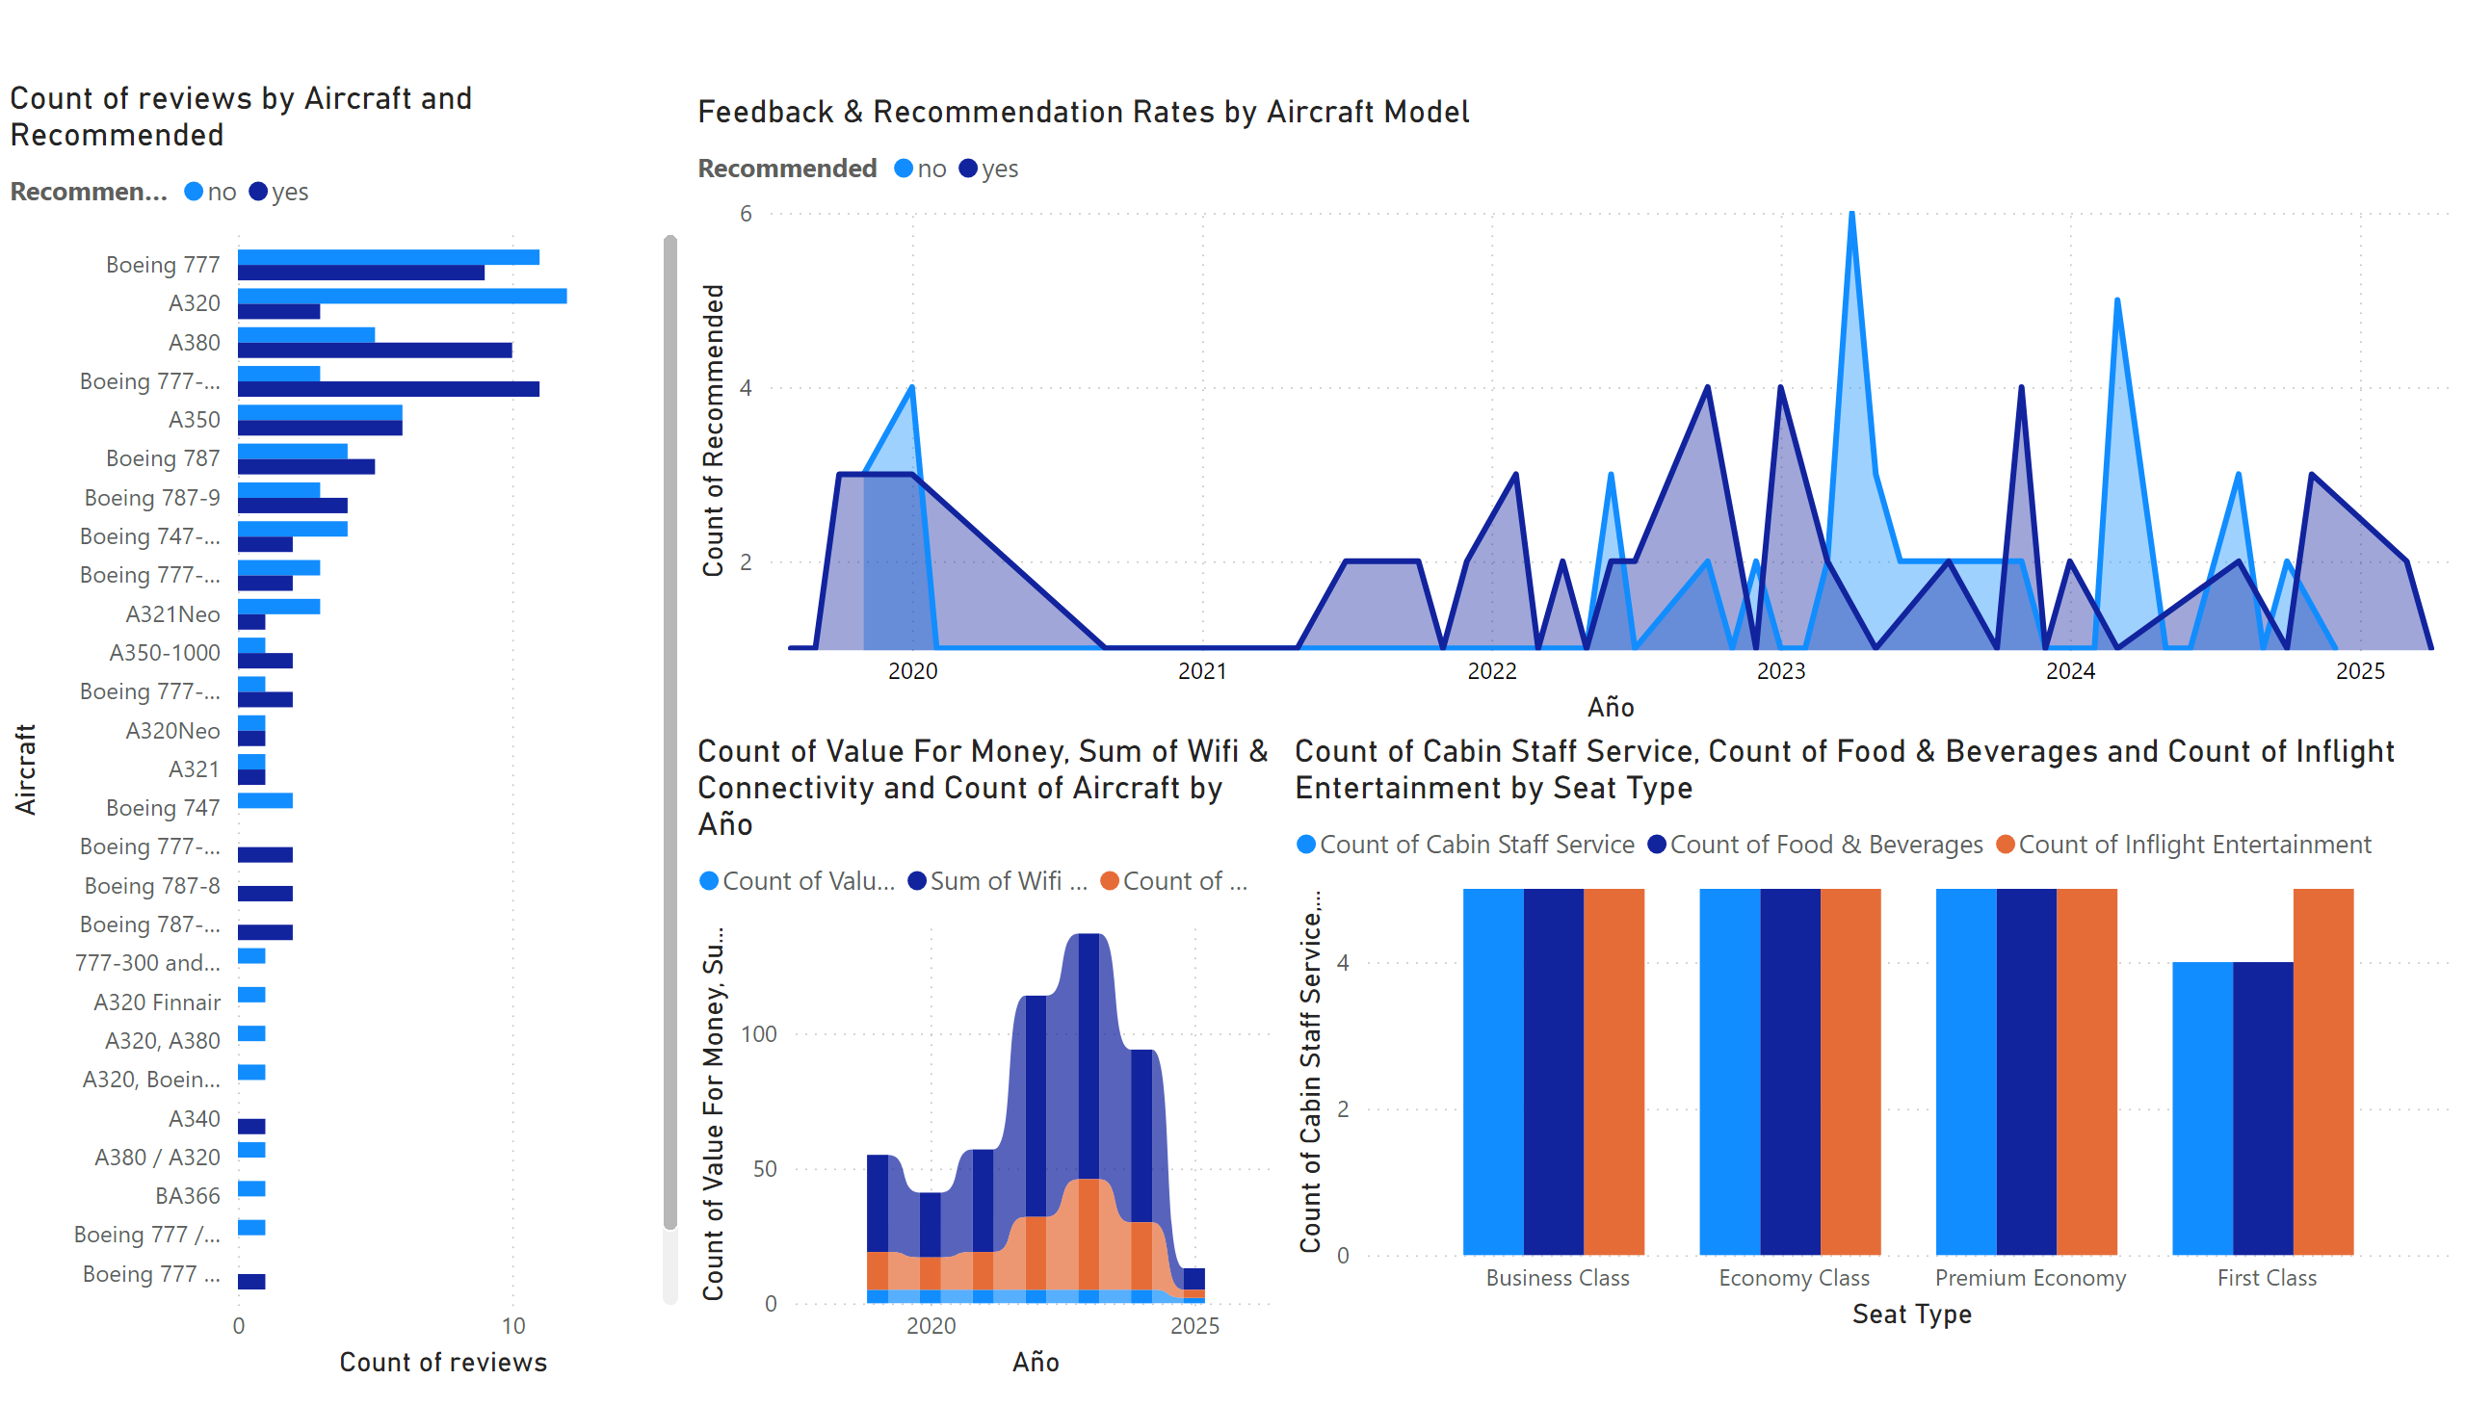
Based on my analysis, I identified several critical flaws in British Airways' service. In 2003, there was a notable rise in negative feedback, primarily driven by Business Class passengers. While First Class saw a decline in complaints, the surge in dissatisfaction from Business Class offset this improvement. This shift left a negative impression on premium passengers, many of whom reported rude interactions with staff and malfunctioning Wi-Fi services in Business Class. Overall, a significant 68.70% of customers expressed dissatisfaction, citing subpar food and beverage quality, poor value for money, and delayed refund processes as major concerns
Food & Beverages:
Long wait times for service
Snacks and drinks often run out before reaching all passengers
Poor taste and quality reported by frequent flyers
Value for Money:
Passengers expect better amenities for the fare paid
Extra charges for basic services (like seat selection or luggage) frustrate travelers
Ticket prices perceived as too high compared to service quality
Poor cost-to-comfort ratio, especially in Economy Class

Slide 2
Page 1
Main Areas for Improvement
🍽 Food & Beverages:
Personalize meal options based on dietary preferences
Partner with renowned food brands for better in-flight meals
💵 Value for Money:
Introduce dynamic pricing based on customer loyalty
Bundle services (Wi-Fi, seating, meals) at a discounted rate
🕒 Refund Process:
Implement real-time refund tracking for customers
Establish a 24/7 dedicated refund support team
Refund Process:
Slow refund processing times
Forced use of vouchers 💲
Delays in customer support response
Focusing on these areas could greatly enhance the overall travel experience and increase customer loyalty for British Airways
Notes:
Feedback & Recommendation Rates by Aircraft Model
No alt text provided
clusteredBarChart
No alt text provided
clusteredColumnChart
No alt text provided
ribbonChart
No alt text provided

